Slide 1
PASSIVE VOICE

Slide 2
Passive Voice be+V3
The teacher dropped the pen. (active)
subject object
The pen was dropped by the teacher.
subject
(passive)
The object of the active verb becomes the subject in the new sentence.

Slide 3
Passive Voice
We use passive forms when:
a) we don`t know WHO did it;
The window was broken an hour ago.
b) we are interested in WHAT happens, not WHO it is done by;
His watch was stolen in the street.
с) the situation is rather formal.
Smoking is not allowed.
d) We want to give emphasis to the action rather than the person who did it.
The form must be signed by all employees.

Slide 4

There are 8 forms of the verbs in the Passive voice.
Present Simple Past Simple Future Simple | am/is/are + V3 was/were + V3 will be/shall be +V3 | The work is done. The work was done. The work will be done.
Present Progressive Past Progressive | is/are being + V3 was/were being+V3 | The work is being done. The work was being done.
Present Perfect Past Perfect Future Perfect | have been + V3 had + V3 will have been +V3 | The work has been done. The work had been done. The work will have been done.

Slide 5

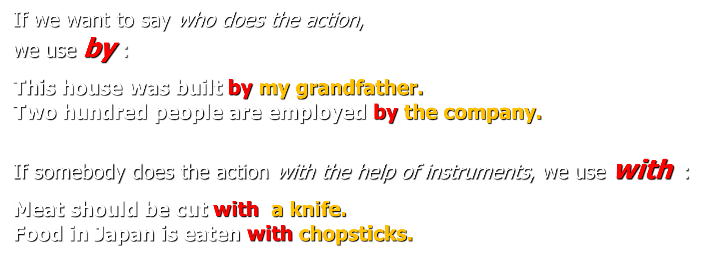
Remember

Slide 6
Answer Key
An unusual way of predicting earthquakes has been discovered by scientists in China – snakes! Snakes at local snake farms are being observed (by experts) to see if their behaviour changes before an earthquake. Cameras are linked to a broadband Internet connection (by scientists). It is believed that earthquakes from 120 km away can be sensed (by snakes), three to four days before they happen. Their nests are abandoned or even walls are smashed into to escape. Because China is struck frequently (by earthquakes), a reliable method of predicting them must be found (by scientists) to avoid the terrible injury and loss of life that is caused (by them/earthquakes)

Slide 7
Answer Key
2 Sarah is having her hand examined.
3 Greg will have his jacket shortened.
4 Sylvia is going to have her hair done for the wedding.
5 I had a bandage put on my ankle.
6 Liz has just had her eyes tested.
7 We have our lawn mowed once a week.
8 They had the roof repaired before they moved in.

Slide 8


